Slide 1
Coffee and Productivity
The-Confabulators

Slide 2



Slide 3


Background
On an individual level, consumption of coffee and its active ingredient, caffeine (a stimulant), is often associated with higher levels of “energy” and “productivity”. But in a given population, such as a nation-state, does higher coffee consumption indicate a higher level of productivity?

Slide 4
Contents
World Coffee Consumption Trend
World Productivity (GDP per Hour Worked) Trend
Top Coffee Consuming Countries
Top Productivity Countries
Correlation Between Coffee Consumption and Productivity
- Does the Amount of Coffee Consumption Affect Productivity?
- Does the Changes in the Coffee Consumption Correlated with the Changes in Productivity?

Slide 5
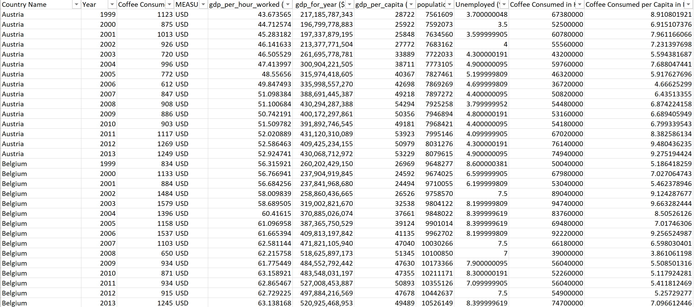
Data Exploration and Data Cleaning

Slide 6
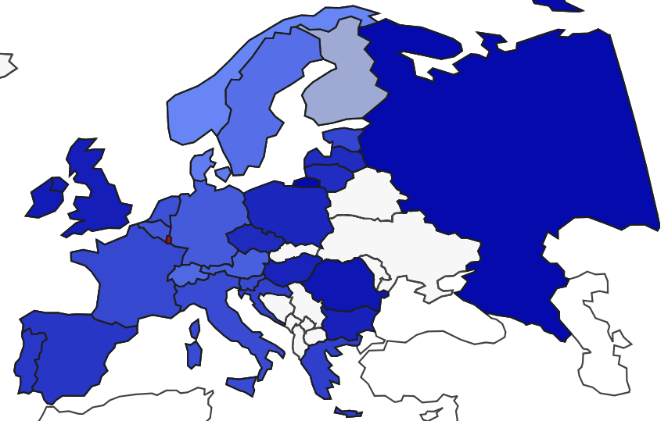


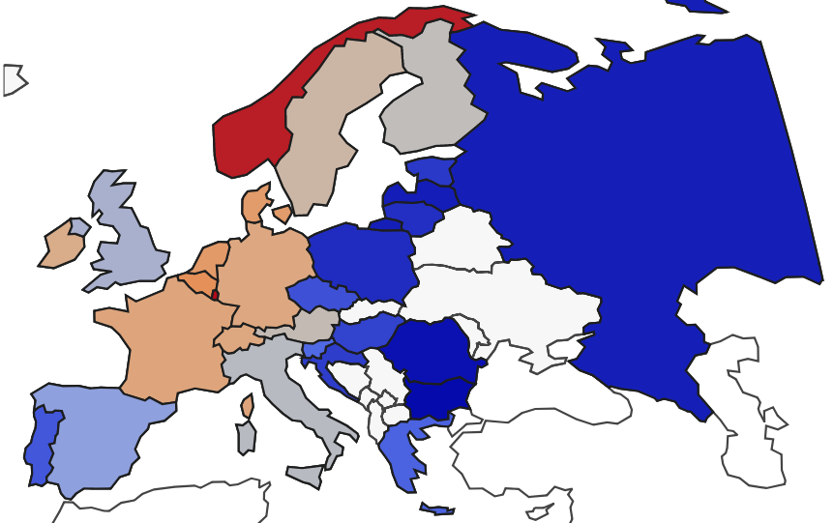

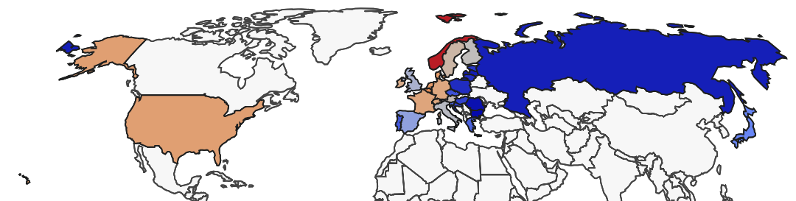
World View – Consumption & Productivity
World Coffee Consumption per Capita (kg)
World Productivity (GDP) per Capita ($)

Slide 7
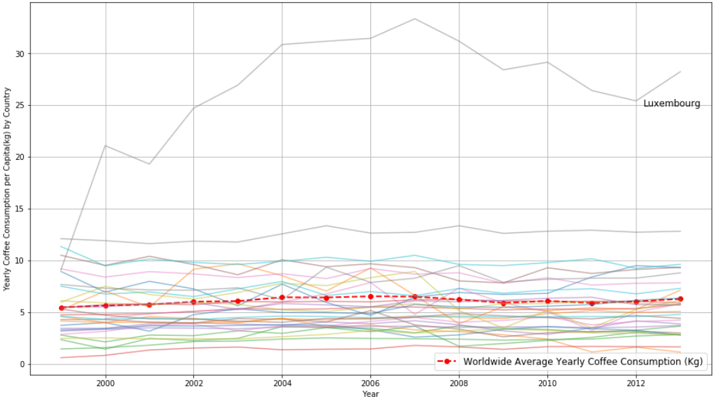
Coffee Consumption Trend by Country

Slide 8
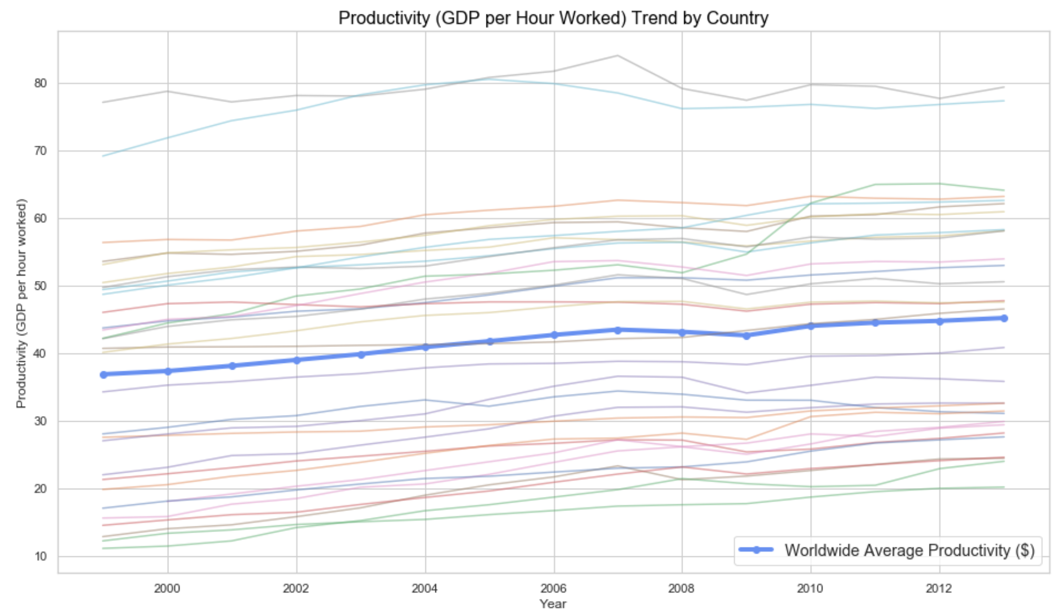
Productivity Trend by Country
Productivity is measured by GDP(Gross Domestic Product) by hour per worked.
Growth in labor productivity indicates a higher level of output for every hour worked.

Slide 9
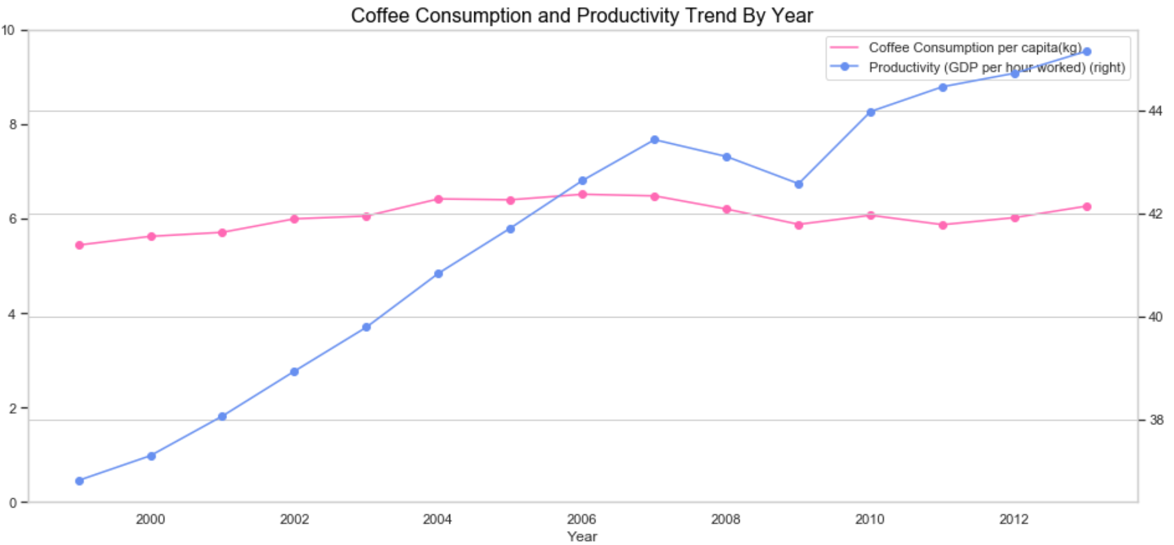
Mean Coffee Consumption and Mean of Productivity by Year

Slide 10
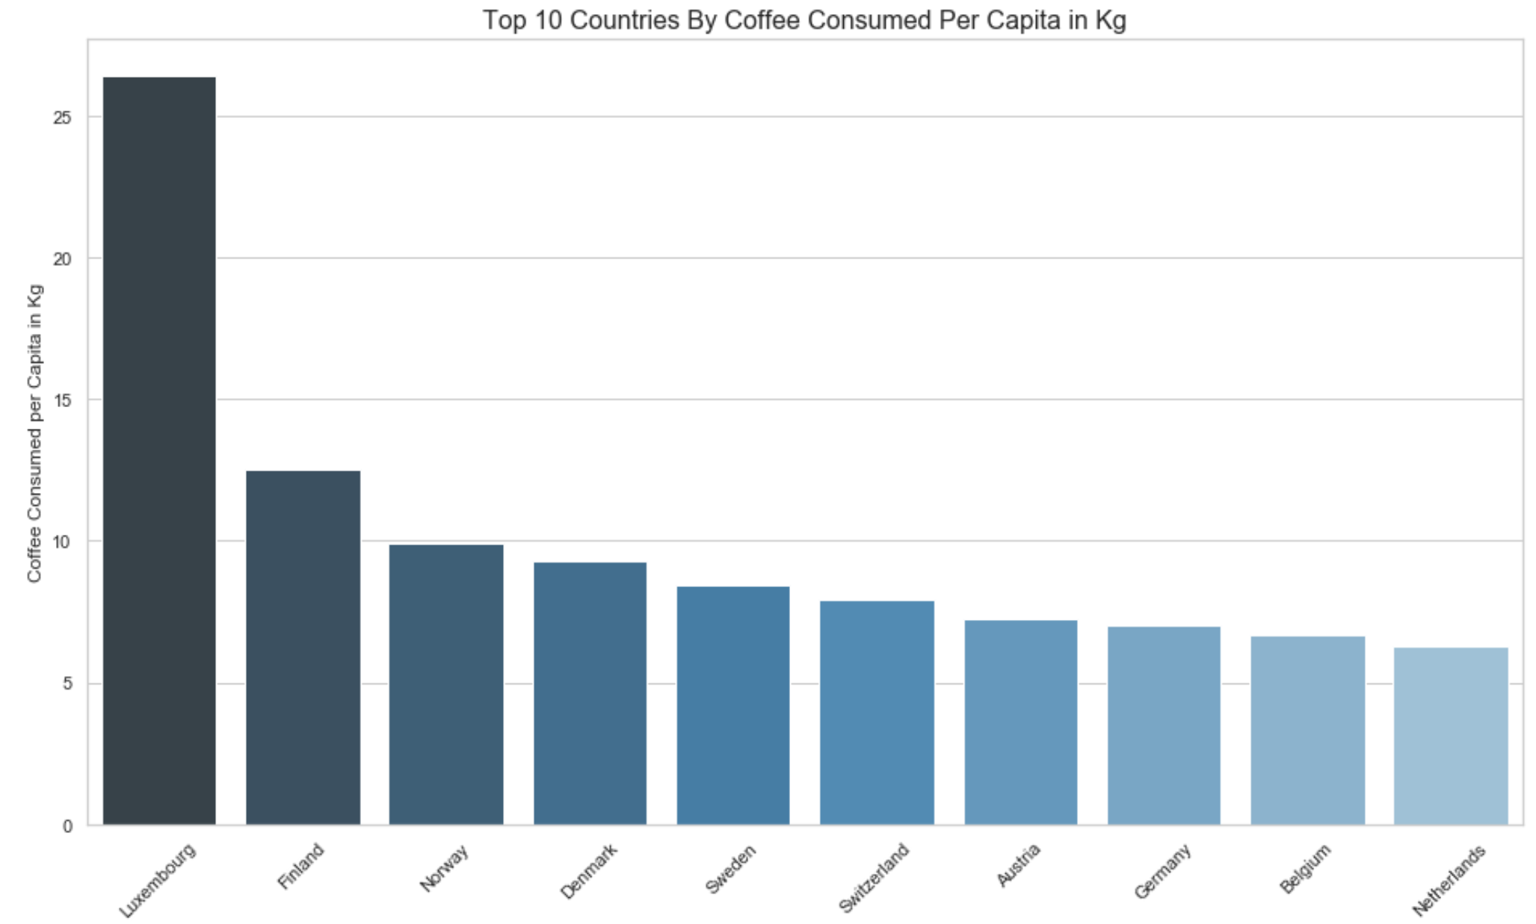
Top Coffee Consuming Countries

Slide 11
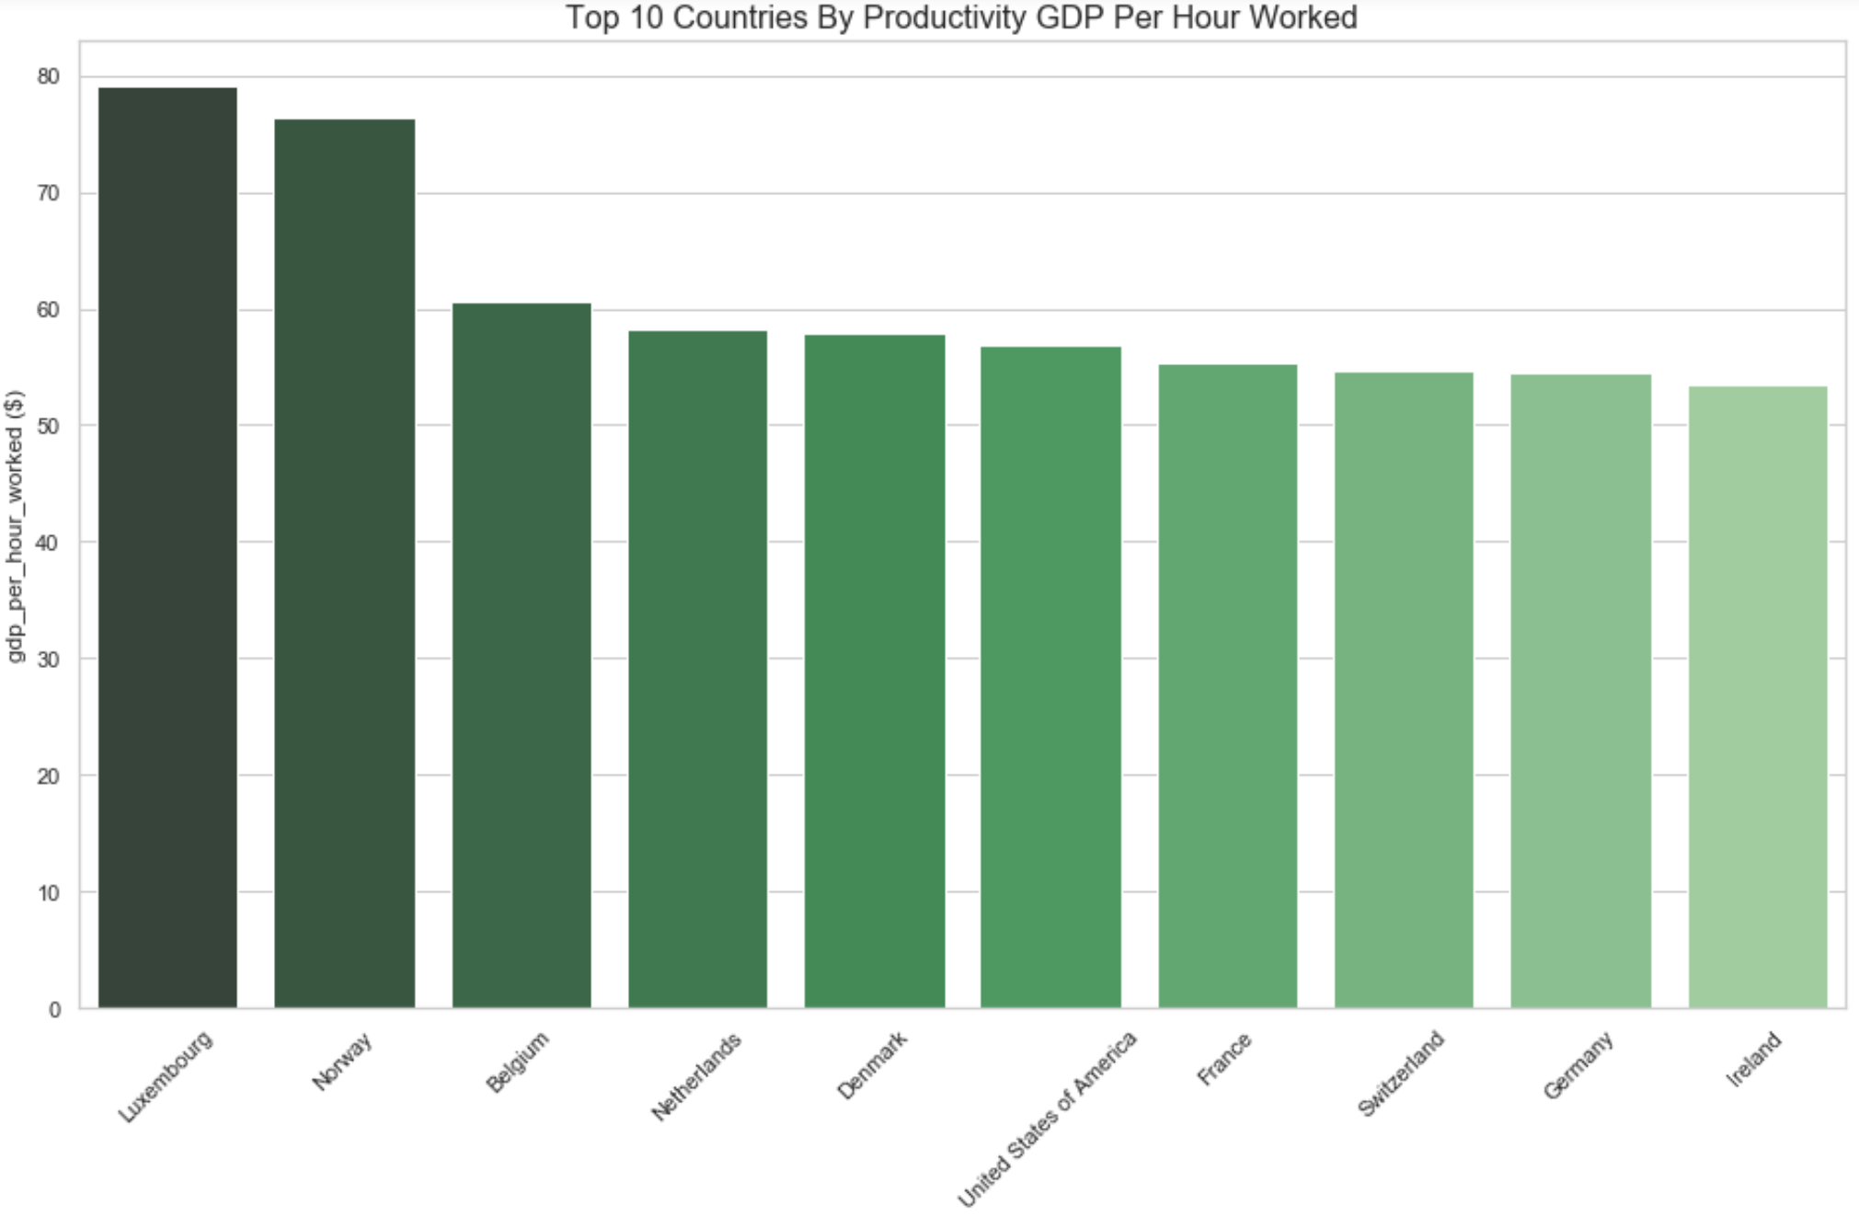
Top Productivity Countries (GDP per hour worked)

Slide 12
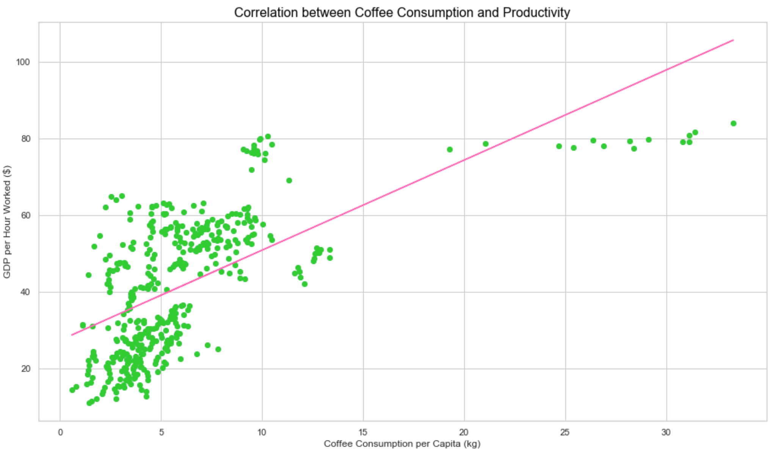

Correlation Between Coffee Consumption and Productivity

Slide 13
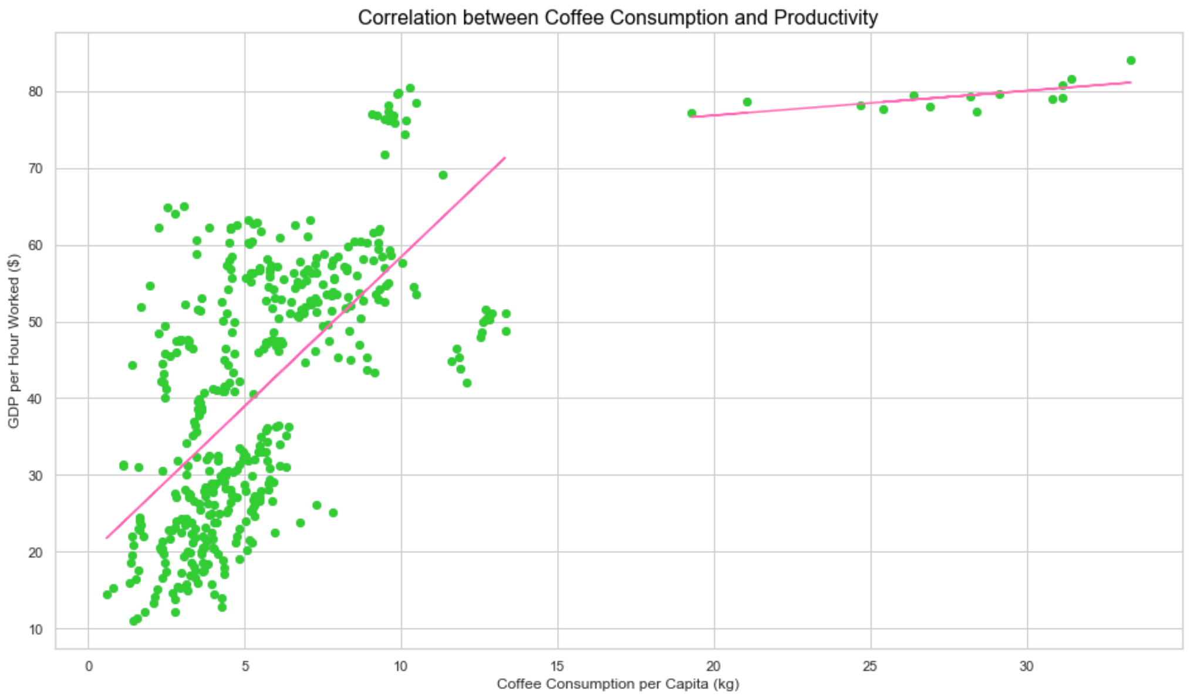


Correlation Between Coffee Consumption and Productivity (Two Cohort)

Slide 14
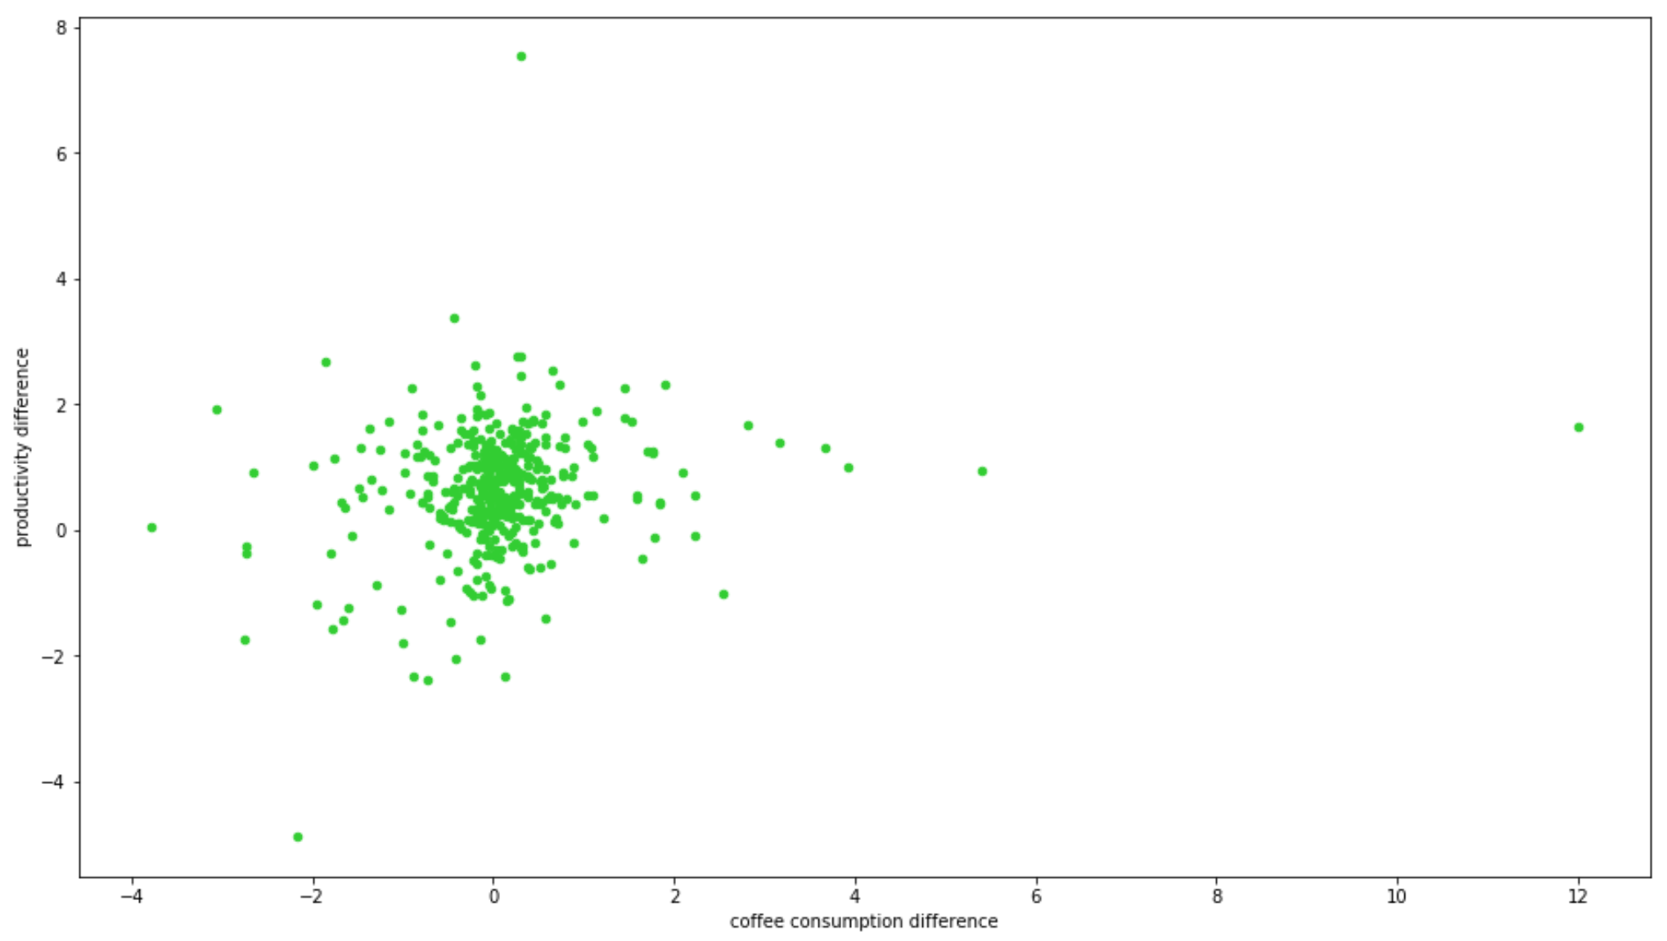
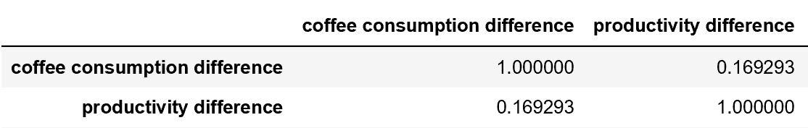
Correlation Between Changes in Coffee Consumption and Changes in Productivity

Slide 15
Conclusions
Amount of coffee consumed and higher productivity measured as GDP per hour worked are correlated.
(p-value < 0.05 and correlation coefficient = 0.633)
According to linear regression, if the amount of coffee consumption is less than 15 kg (33 lbs), productivity increases much faster (bigger slope), while the productivity decreases slowly when the consumption is larger than 15 kg (slope: m_{<15} = 3.89, m_{>15} = 0.32),
The changes in coffee consumption do not directly affect the changes of productivity. This is because there are several factors that decide productivity and coffee is not the only factor for productivity.

